Slide 1

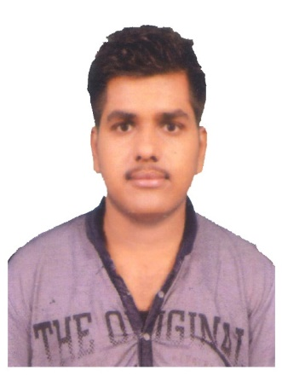
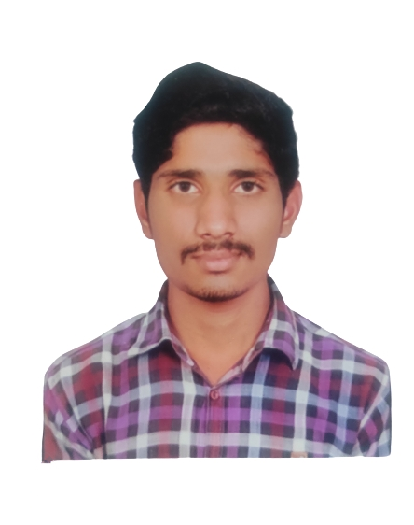





Shaik Mahammad Khasim
Education and certificates
Master Of Computer Application(M.C.A): 2019 - 2021
Analyst/Software Engineer
Base Location: ^{Bangalore}
Skills
Core java
J2EE(JDBC,Servlets,JSP)
MY SQL
PL/SQL
Manual testing(Agile, SDLC)
Email ID:
shaik-Mahammad.khasim@capgemini.com
_{Mobile No:} +91 7730963775
Grade:
A4
Backend
Java Script
MongoDB
REST-API
NodeJS
Strengths
A self driven learner with Front-End and Back-End knowledge. Passionate about implementing and launching new projects.
Ready to learn new technologies/Frameworks and implement them to further improve my knowledge.
A team player with good communication skill always ready to work for the enrichment of knowledge.
Has working knowledge on Angular and Java Microservice Development using Spring framework on an intermediate level.
Achivement
Academic project: Detection of fake online review using semi-supervised and supervised learning
In this module, the Admin has to login by using valid username and password. After login successful he can do some operations, such as View All Users and Authorize, Add Movie, View All Movies, View All Movie Reviews, View All Reviews by Rates, View All Movie Recommendations, View All Interesting and Uninteresting Movies, View All Search History, View All Purchased items and booked Movie ,View All Fake Reviews By Movie, View All Fake Reviews By Region, View All Fake Reviews by Rates ,View Movies Rank in chart
.
Database
SQL database – MySQL
No SQL database – MongoDB
Web Technologies
HTML5
CSS3
JavaScript/TypeScript
Coded and designed Static Web Pages
AddOns Github Maven Postman
Developed website with HTML5 and CSS3 Along Frameworks like SASS(Syntactically awesome style sheets) to make website more interactive and dynamic.
Also Implemented Eureka Server and Semantic UI in case study and upskilling day by day.
Training, Certifications & Affiliations
Java Full stack and Manual Testing Training from J Spiders BTM 2nd Stage, Bangalore
Additional Details
Excellent Communication Skills
Team Player
Check oumy work on GitHub & Video Profile
Presentation Title | Author | Date © Capgemini 2017. All rights reserved | 1

